Slide 1
变量和输入输出

Slide 2
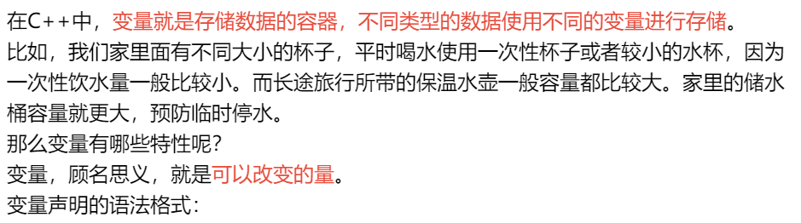
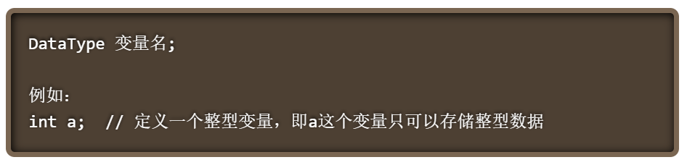
什么是变量？

Slide 3
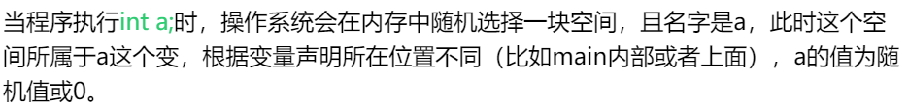
a

Slide 4
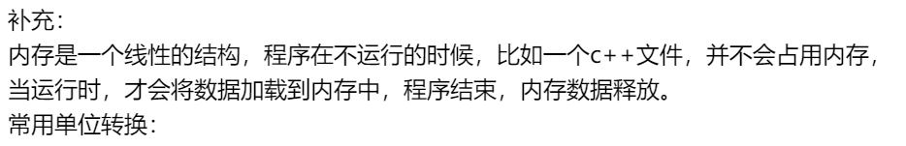
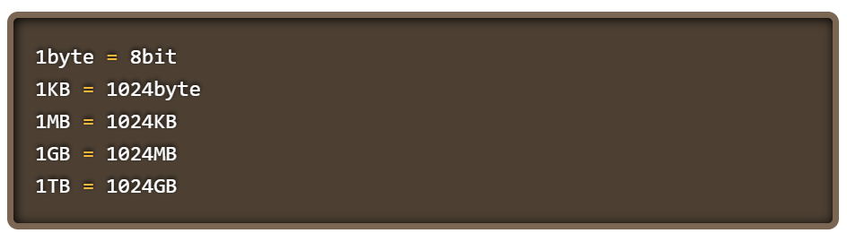

Slide 5
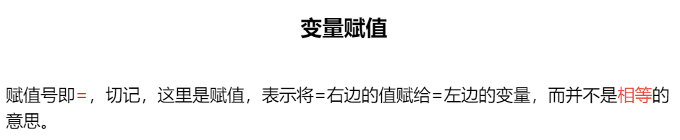
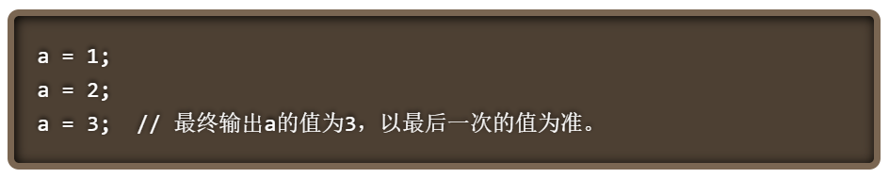
 |  |  |  |  |  |  |  |  | 3
a

Slide 6
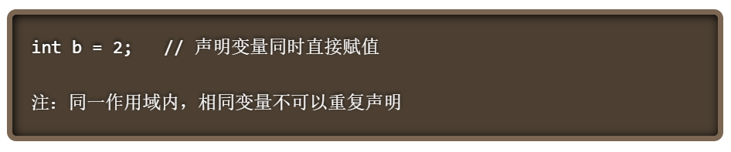

Slide 7
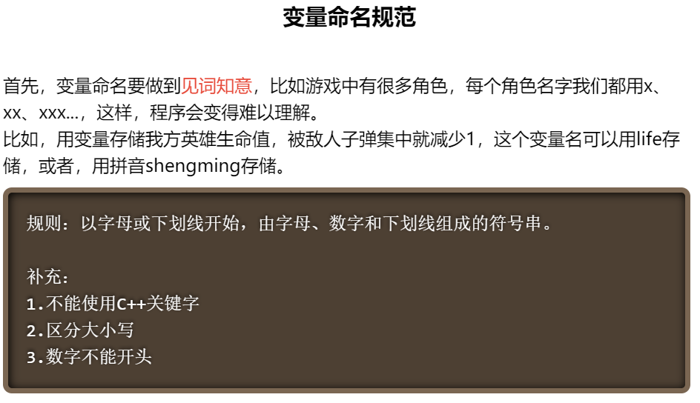

Slide 8
例如
int Score1 = 90 ;
int Score2 = 75 ;
int Temp = Score2;
Score2 = Score1;
Score1 = Temp;

Slide 9
例如
int Score1 = 90 ;
int Score2 = 75 ;
int Temp = Score2;
Score2 = Score1;
Score1 = Temp;
Score1
90
Score2
75
Temp

Slide 10
例如
int Score1 = 90 ;
int Score2 = 75 ;
int Temp = Score2;
Score2 = Score1;
Score1 = Temp;
Score1
90
Score2
75
Temp
75

Slide 11
例如
int Score1 = 90 ;
int Score2 = 75 ;
int Temp = Score2;
Score2 = Score1;
Score1 = Temp;
90
90
Score1
Score2
75
Temp
75

Slide 12
例如
int Score1 = 90 ;
int Score2 = 75 ;
int Temp = Score2;
Score2 = Score1;
Score1 = Temp;
75
Score1
90
Score2
90
Temp
75

Slide 13
复合赋值运算
A = A op B
可以缩写成：A op = B
例：
c = c - k
c - = k
x = x + 3
x + = 3
x = x % 3
x % = 3
x = x * ( y + 8 )
x * = y + 8

Slide 14
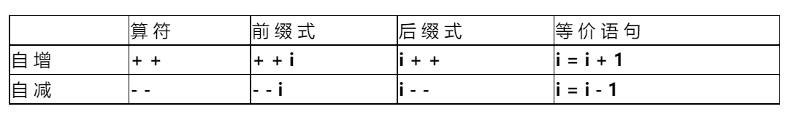
变量自增自减

Slide 15


